Slide 1
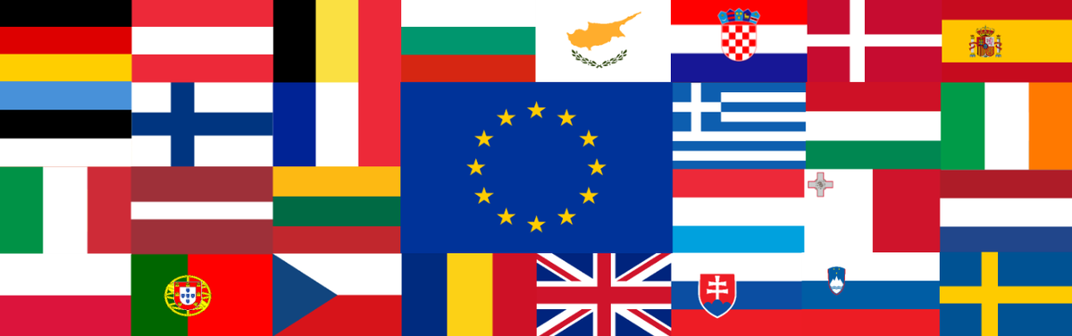
EU copyright harmonization:
An empirical analysis of Dutch courts decisions
Treehill – CC BY,SA 3.0
Prof. Estelle Derclaye
University of Nottingham
7 February 2025
Notes:
Thanks, water, watch

Slide 2
Overview
Gap and methodology
Findings
Conclusion
Q&A

Slide 3
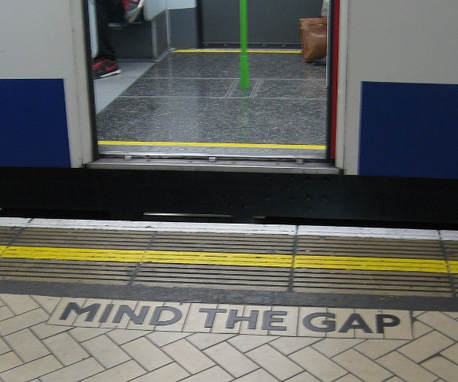
Gap & methodology
By WillMcC - Own work, CC BY-SA 3.0
https://commons.wikimedia.org/w/index.php?curid=4379199
A lot written on CJEU case law but not on how Member States’ courts apply it => fills this gap
Hypothesis/RQ: is there is disharmony in national case law (i.e. courts’ decisions do not comply with the copyright acquis) + is it owed to misimplementing EU copyright legislation or misinterpreting CJEU case law
Funded by ESRC Impact Accelerator Account, British Academy and Google: 50 most recent court decisions on copyright law’s limits handed down by the civil courts at all levels in all Member States + UK

Slide 4
Methodology (cont’d)
Cut off date 21/4/2021 (not beyond 2000 or beyond joining EU), mostly publicly accessible databases + Darts-IP, research assistants
Compliant with the acquis (directives/regulation + CJEU case law) = national court neither contradicts the letter nor the spirit of the acquis (i.e. if it adds to the directives, CJEU’s interpretation, it does not contradict it)
Non-compliant decisions contradict letter or spirit of the acquis (so if it adds to it, it contradicts it) so those which, for instance, apply different (or not all) conditions or criteria etc than those set out by EU legislation or by CJEU

Slide 5
Detailed RQ
This main question can be subdivided into three sub-questions:
  a. Is this owing to inconsistent, unclear or imprecise CJEU case law in some areas?
  b. Is this owing to lack of clarity in EU legislation in the areas where there is no CJEU case law?
  c. Is this owed to resistance by some national courts on a specific topic?

Slide 6
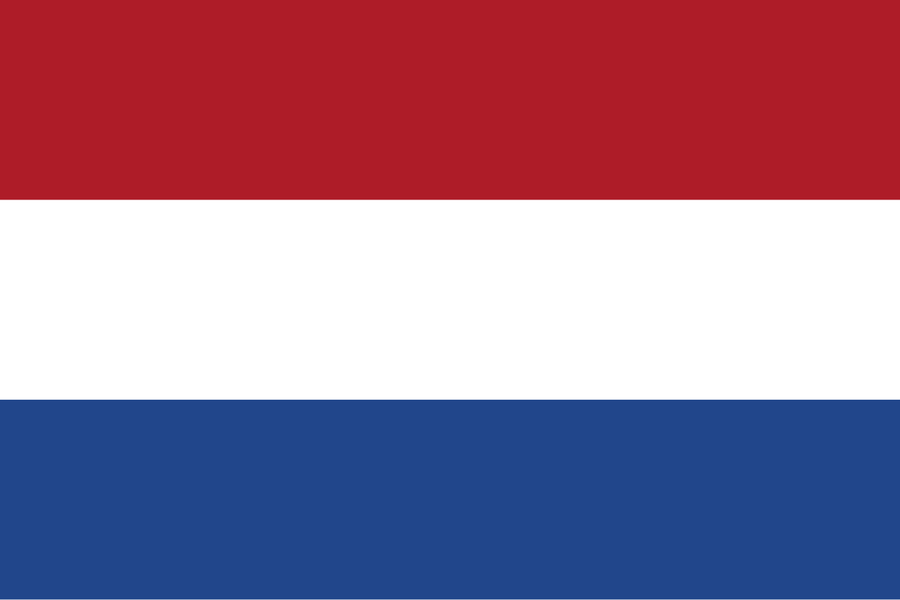
General stats
Decisions span 2014 to 2021
But those from 2014 up to 2017 = CFI decisions of CA decisions decided between 2018 and 2020
Decisions: 1 Hoge Raad, 5 CA, rest CFIs
Vast majority decisions are on originality, then reproduction and on communication to the public & making available rights; notably 25 are on 3D functional works and this is also the most litigated upon

Slide 7

Compliance rate
20 non-compliant – on originality and infringement test all owed to courts not applying the CJEU case law correctly
This talk focuses on the non-compliant decisions (‘NC’) esp. those on the infringement test namely
  Case 200.258.243/01, Philips v Lidl, CA The Hague, 06/04/2021; case 200.277.196/01, Airwair v Primark, CA Amsterdam, 13/04/2021; case 200.192.044/01, Arpe v Happy Cocooning, CA the Hague, 20/02/2018; CA the Hague, 09/03/2021, case 200.265.693/01, Diesel v Calvin Klein; CFI Amsterdam, 7/12/2020, case C/13/692236/KG SA 20-985, Sony v B; CFI The Hague, 18/11/2020, case C/09/59904/KG ZA 20-837, Smart Urban Mobility v Azor Bike.

Slide 8
Originality
Generally compliant, apply Infopaq and its progeny correctly. Only three courts add a test of overall impression
  Case NL18.18302, A v B et al., CFI Utrecht, 02/09/2019 (tent). (coded compliant as pre-Cofemel)
  Case C/09/586257/KG SA 20-7, De Spieghel v Decor Wonen, CFI The Hague, 07/04/2020 (chair). (NC)
  Case 200.258.243/01, CA The Hague, 06/04/2021, Philips v Lidl aff’d by Philips v Lidl, ECLI:NL:2023:1070, Dutch Supreme Court, 7 July 2023 (NC) (see next slide)

Slide 9
Infringement test - 1
The non-compliant cases were decided by many different courts: CFI The Hague (2), CA The Hague (3), CA Amsterdam, CFI Rotterdam, CFI Amsterdam, CFI Overijsel, CFI Haarlem (each one case).
All decided by differently composed courts => general trend among courts to use these tests, i.e. it not down to one particular judge.
14 of those 22 cases concerned works of applied art
Trend carries on beyond 2021, see e.g. Rubik’s cube

Slide 10
Infringement test - 2
In all but 6 of the 22 cases on the reproduction or other rights (communication to the public) which discuss the infringement test, courts use the test of overall impression (sometimes also adding a comparison of the differences and similarities) instead or in addition – far more rarely - to the AOIC Infopaq test.

Slide 11
Infringement test - 3
In some cases, however courts acknowledge that the original elements are decisive but it does not mean that the courts do not examine the non-original elements
Some courts also state that unprotected elements must also be taken into account if together they form a creative combination = OK but then again, courts do not check that defendants have taken those combinations in the infringement phase
Courts often 2013 HR decisions (Stokke) not CJEU

Slide 12
Some recent examples

Slide 13
1. CA The Hague, 6/4/2021 (1)
Phillips v Lidl (SensoTouch 3D v Silvercrest razors)

Slide 14
CA The Hague, 6/4/2021 (2)
CA held STD3 not original because builds on previous Arcitec, uses AOIC but also overall impression but decides to nevertheless looks into infringement
The court focuses on the differences between the 2 shavers at paras 4.17, 4.17.1-4.17.7
Different use of materials is also considered (4.17.3).
The court also uses an overall impression test when discussing differences, e.g.:

Slide 15
CA The Hague, 6/4/2021 (3)
  “4.17.7. On top of this, certain features shared by the Arcitec and the ST3D are not reflected in the Silvercrest, such as the line rising vertically from the bottom in the middle of the handle, which only slopes away and continues upwards shortly below the shaving head holder.”
It barely looks into similarities and concludes
  4.18 “… those similarities are too limited to give the Silvercrest shavers the same overall impression as the ST3D”
  4.19 “The different overall impression of the Silvercrest is reinforced by the black 'collar' with which the devices marketed by Lidl et al are equipped.”

Slide 16
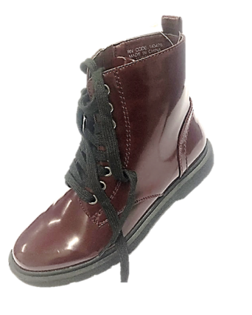
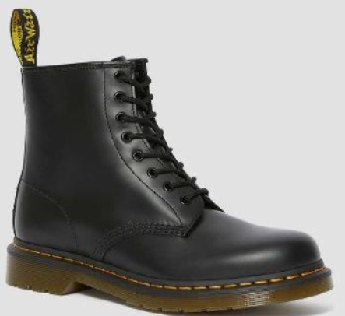
2. CA Amsterdam, 13/04/2021 (1)
Airwair v Primark. Several DocMartens boots models, one example:

Slide 17
2. CA Amsterdam, 13/04/2021 (2)
Para 4.4: “Whether there is an infringement of a copyright in an object of use depends on the extent to which the overall impressions of the allegedly infringing work and the allegedly edited or imitated work correspond. When comparing the overall impressions, the protected features or elements of the latter work are decisive, on the understanding that a combination of elements that are not protected in themselves can also be an (original) work within the meaning of the Copyright Act, provided that this combination bears the personal stamp of the creator. Furthermore, the starting point is that a certain style or trend does not deserve copyright protection.”
Again the court focuses on differences and uses an overall impression test only referring to AOIC to state that Primark’s shoe is original

Slide 18
3. Arpe v Happy Cocooning, CA The Hague, 20/02/2018
Court clearly made the link between original characteristics of claimant’s work (table gas fires) that defendant copied
However, while it said that 3 original elements were taken by defendant, because the most characteristic one had not been taken => no infringement => NC

Slide 19
Contrast with other wording
e.g. CFI The Hague, 07/08/2019, case n. C/09/513126 / HA ZA 16-735, MVSA et al. v Invert GCV (interior design of a shoe shop), para 5.19. “In order to determine whether there is a similarity in the same sense, it is a question of whether the allegedly infringing work has the copyright-protected features of the earlier work to such an extent that the overall impressions made by the two works differ too little for the opinion that the first work can be regarded as an independent work”
=> Compliant

Slide 20
CFI Rotterdam, 10/04/2020, A v B (1)
Defendant put claimant’s photos on a website. No discussion of infringement:
  ‘He asked attendees at the event to send him photos. It is not illogical that [the defendant] trusted that the people who sent the photos thereby gave permission for the re-publicization of the photos in question, because he had explicitly requested the photos for that purpose. In doing so, [the defendant] has fulfilled his duty of care, which duty of care may not be imposed too high in the case of a non-professional party such as [defendant].’
Notes:
case n. 7953739 CV EXPL 19-33331

Slide 21
CFI Rotterdam, 10/04/2020 (2)
Defendant took down photos immediate when asked.
Court held defendant not liable. Perhaps it was because there was an implied licence but not clear.
Should have said there was infringement of communication to the public right but no damages (and no injunction as photos already withdrawn)

Slide 22
Other Member States
Various breaches but mostly on infringement, originality and exceptions
A minority of national courts do not comply ie 14% overall in all 28 countries.
Highest non-compliant countries = DK, LU, NL, B and NC mostly on functional works
Other Member States courts use overall impression too e.g. B, LUX, DK, SW
Some Belgian courts use prior art to decide originality of WAA

Slide 23

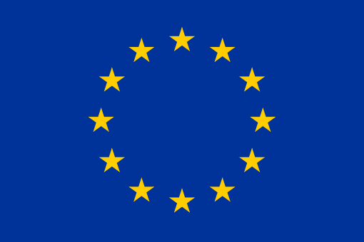
Conclusion - NL
Bad compliance on certain topics mainly infringement test: is the reason resistance, tradition, misunderstanding, unawareness, all or some of those?
Have I missed any decision? Misinterpreted something?

Slide 24
My publications on the topic
Editorial - Is Copyright Harmonisation in the EU Achieved in Practice and If Not, What Can We Do About It? (2024) Grur Int 605-606.
"To What Extent is the Parody Exception Truly Harmonised? An Empirical analysis of the Member States’ Case Law Post-Deckmyn“ (2023) IPQ 59-81
“The status of three-dimensional functional works post-Cofemel. An empirical analysis of the Member States’ case law”, Reto Hilty’s Festschrift, 2024, p. 121-138.
ECS annual conference 2023 presentation giving stats and discussion of the database sui generis right
Forthcoming book, Derclaye & Stupfler, EU copyright harmonisation, An Empirical Analysis of the National Case Law, Hart//Bloomsbury (2025)

Slide 25
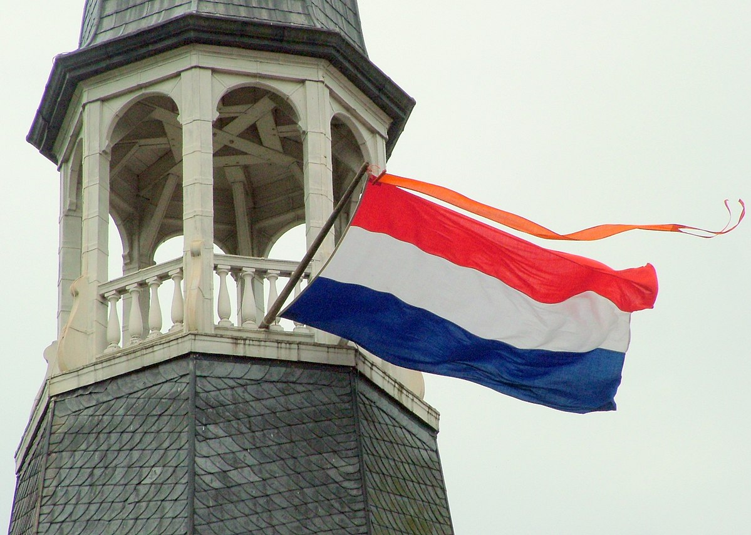
Dank u wel voor uw aandacht! Vragen?
Photo by Ziko-C
https://www.nottingham.ac.uk/law/people/estelle.derclaye Estelle.Derclaye@nottingham.ac.uk
https://math.univ-angers.fr/~stupfler/
gilles.stupfler@univ-angers.fr

